Slide 1
Introduction to Async Programming
Concurrency in C#
Notes:
E un topic in care am vazut multe confuzii. Ori nu se stie de existenta unor functionalitati ori se folosesc gresit
Poate creste perfromanta/responsiveness. Ajuta la folosirea resurselor existente cat mai efficient. Ajuta la scalabilitate

Slide 2
Agenda
What is concurrency
Processes
Threads
Async
Parallel processing
Concurrent collections
Pitfalls
Processes, Threads and Asynchronous Programming

Slide 3
What is concurrency
Concurrency: Doing more than one thing at a time
Multithreading: A form of concurrency that uses multiple threads of execution
Asynchronous Programming: A form o concurrency that uses callbacks to avoid unnecessary threads
Parallel Processing: Doing lots of work by dividing it up among multiple threads that run concurrently
Reactive Programming: A declarative style of programming where the application reacts to events

Slide 4
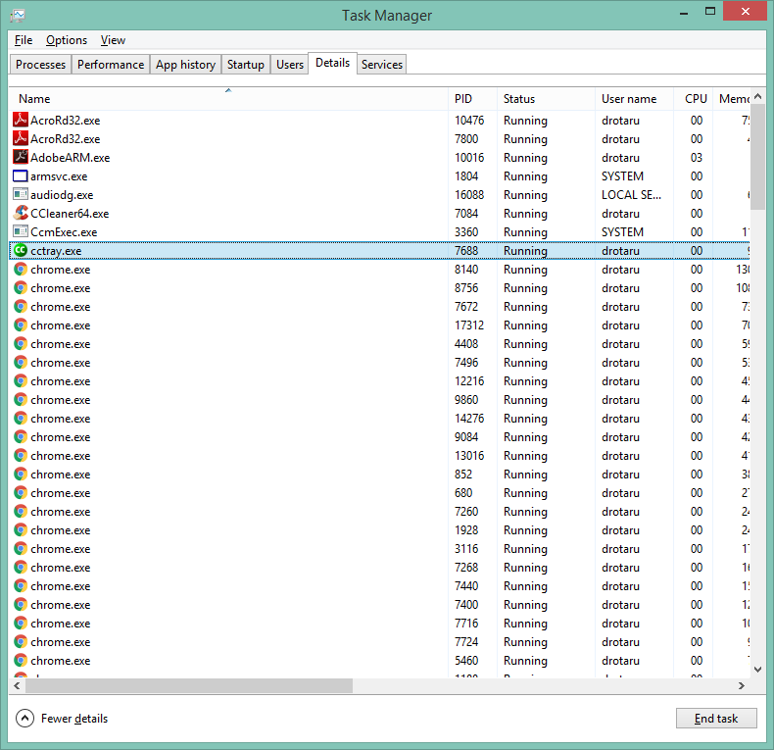
Processes
What is a process
A process is the set of resources that comprise a running program
A process contains only a single thread, which executes from the beginning of the program to the end

Slide 5
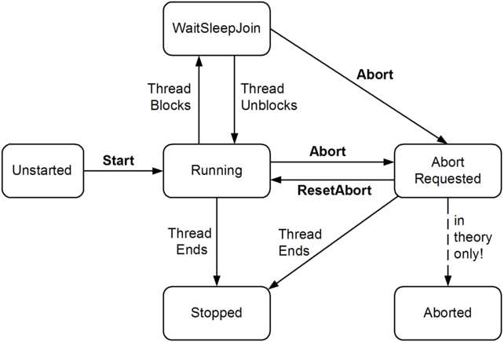
Threads
What is a thread
A thread is defined as the execution path of a program
More than one thread can execute code inside the same process.
More threads do not mean more performance (more resource consumed, context switching, complexity)
Notes:
Fiecare thread are stackul lui dar imparte aceeasi zona de memorie cu celelalte threaduri din proces.
Threaduri speciale: UI thread, Main thread (consoleApp)
Toate aplicatiile .NET au un thread pool. Thread pool-ul controleaza un numar de worker threads (IO or normal threads). Threadpool-ul decide de cate threaduri e nevoie in orice moment. Sunt ft multe configurari care pot modifica acest comportament, dar recomandarea e sa nu le atingeti; threapool-ul este configurat incat sa acopere o vasta majoritate of real-world scenarios.
Un thread este o abstractie low-level. Thread-poolul este o abstractie mai high-level; cand din cod se cere executarea pe un thread nou, thread-poolul se va ocupa de crearea unui thread nou in caz ca e necesar.

Slide 6
Async
What is it?
When to use it?
Asynchronous operations
How does an async method works?
Context.
Notes:
A future (or promise) is a type that represents some operation that will complete in the future. Common futures types in .NET are Task and Task<TResult>.
Cand ai de asteptat dupa operatii cu Input/Output.
Operatii asincrone: HTTP requests, working with database, calling webservices.
prima data se porneste executia sincron, la fel ca o metoda sincrona. La intalnirea cuvantului await se va face un wait asincron pe argument. Prima data verifica daca operatia este finalizata; caz in care continua executia metodei sincron. Altfel, metoda va fi pusa pe pauza si se va intorce un task incomplet. Cand metoda va fi finalizata, metoda async isi va continua executia
Cand se asteapta un task, contextul este capturat cand await decide sa puna metoda pe pauza. Acest context este deobicei SynchronizationContext in caz ca nu este null, altfel contextul este the current TaskScheduler. Cand se termina de asteptat metoda continua executia in contextul capturat. De obicei, acest context este UI/ASP request context sau the ThreadPool.

Slide 7
Async – await
WhenAll
Waits for multiple tasks to finish
Catching exceptions. AgregateException
WhenAny
takes a sequence of tasks and returns a task that completes when any of the tasks complete.
Cancelation
ThrowIfCancellationRequested()
Timeouts
Notes:
Daca un singur task arunca o exceptie atunci when all va rearunca exceptia mai departe. Daca mai multe taskuri arunca exceptii atunci toate aceste vor fi impachetate intr-o exceptie de tipul AgregateException
Se termina atunci cand prima operatie este terminata. Tot timpul se termina cu status de succes. Daca prima operatie arunca o eroare singurul mod in care o putem prinde e sa asteptam si rezultatul (vezi cod)
token.ThrowIfCancellationRequested() pt operatii lungi.. Pot fi intrerute in timpul procesarii in loc sa consume resurse intutil. Combined tokens: CreateLinkedTokenSource

Slide 8
Parallel processing
What is it?
When to use it?
How does it work?
Notes:
Parallel programming is used to split up CPU-bound pieces of work and divide them among multiple threads
Procesarea paralela ar trebui sa fie folosita cand exista o cantitate ridicata de procesare ce poate fi impartita in bucati mai mici
Creste gradul de incarcarea procesorului pt o perioada de timp pt a mari throughput-ul. Se preteaza ft bine la aplicatii desktop (unde procesorul este in mare parte idle) si mai putin la cele server (care oricum, deobicei, deserevesc requesturi multiple in paralel)

Slide 9
Types of parallelism
Data parallelism
Perform the same operation on each element of a collection
Parallel.ForEach
Parallel.For
PLINQ
Task parallelism
When you have a pool of work to do, and each piece of work is mostly independent from the other pieces
Parallel.Invoke
Task.Run
Task.Factory.StartNew
Notes:
Parallel LINQ (PLINQ) are o alternativa la Parallel.ForEach folosind sintaxa LINQ. Diferenta majora inter cele 2 este ca PLINQ presupune ca poate folosi toate core-urile de pe masina, pe cand Parallel va reactiona dinamic la schimbarile de load ale procesorului
Parallel.For() de folos in care ai nevoie de index
Se poate controla nr de threaduri

Slide 10
Concurrent collections
Concurrent
Enables writing data from multiple threads in a safe way
Most of the times are faster than non-concurrent collections with locking mechanism
ConcurrentDictionary
Immutable
Cannot be modified
Each time a element is modified (added or removed) a new collection is created. Even though this sounds expensive in practice most of the elements of the new collection are reused from the old collection.
All operation of a immutable collection are pure
ImmutableStacks, ImmutableList, ImmutableHashSet, ImmutableSortedSet, ImmutableDictionary
Producer/Consumer
They allow (possibly multiple) producers to push items to a collection while allowing (possibly multiple) consumers to pull items out of the collection.
Can be blocking or asynchronous
BlockingCollection
Notes:
ConcurrentDictionary
Ft buna pt data sharing. Warning sunt situatii in care pt o singura apelare, ambele metode de insert si update sunt executate de mai multe ori. Recomndata ca delegatul sa fie cat mai simplu si idempotent. In cazul in care updaturile nu sunt dese, ImmutableDictionary ar putea fi o alegere mai buna. In cazul in care unele threaduri doar adauga elemente si altele doar extrag, o colectie P/C ar putea fi o alegere mai buna
ImmutableStacks
Asemanatoare ca performanta fata de un Stack mutabil. Pt scenarii simple incare colectia este updatata des diferenta de performanta este mult mai mare fata de un stack mutabil. Ft bune pt date care sunt folosite de multiple threaduri. Nu e recomandat pt comunicarea intre threaduri (P/C)
BlockingCollection
Poate fi blocat numarul maxim de elemente pt cazul in care producerii is mai rapizi decat consumerii. Nu e recomandat daca consumerul e UI. Pt asta exista AsyncProducerConsumerQueue (sunt optiuni mai bune in librarii gen Nito sau TPL). Default se comporta ca o coada. Poate fi transformata in stiva

Slide 11
Pitfalls
Avoid async void
Avoid using .Result and .Wait()
Use await for asynchronous code
Use .GetAwaiter().GetResult() for synchronous code
Use .ConfigureAwait(false) when calling thread isn’t needed
Most business logic doesn't need to return to the calling thread
This only applies to .NET Framework 4.X
Avoid return await
When await is only used in return statement, return the Task instead
Caution: Don’t do this inside of try/catch & using() blocks
There are libraries which does not implement async methods in an async manner (Oracle)

Slide 12
Bibliography
Concurrency in C# Cookbook
Stephen Cleary blog post series about async-await (at least: There is no thread)

